Slide 1
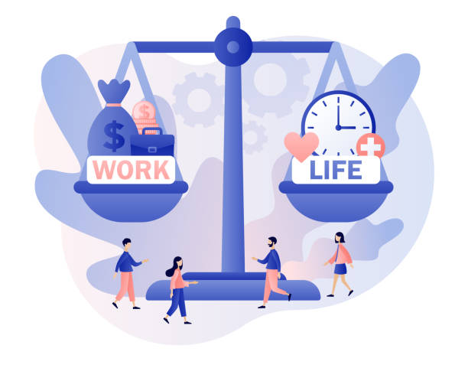

Presented by : Yasika Sawant Course : Marketing Models Professor : Dr. Sethna
Factor Analysis on Wellbeing and Lifestyle

Slide 2

Methodology :
Imported Data set in IBM SPSS
TOTAL 20 VARIABLES IN DATASET
Two methods used for factor Analysis
Final Output

Slide 3
Dataset :
20 Variables of Wellbeing and Lifestyle | Abbreviations
HOW MANY FRUITS OR VEGETABLES DO YOU EAT EVERYDAY?* | FRUITS_VEGGIES
HOW MUCH STRESS DO YOU TYPICALLY EXPERIENCE EVERYDAY?* | DAILY_STRESS
HOW MANY NEW PLACES DO YOU VISIT? | PLACES_VISITED
HOW MANY PEOPLE ARE VERY CLOSE TO YOU?* | CORE_CIRCLE
HOW MANY PEOPLE DO YOU HELP ACHIEVE A BETTER LIFE?* | SUPPORTING_OTHERS
WITH HOW MANY PEOPLE DO YOU INTERACT WITH DURING A TYPICAL DAY?* | SOCIAL_NETWORK
HOW MANY REMARKABLE ACHIEVEMENTS ARE YOU PROUD OF?* | ACHIEVEMENT
HOW MANY TIMES DO YOU DONATE YOUR TIME OR MONEY TO GOOD CAUSES?* | DONATION
WHAT IS YOUR BODY MASS INDEX (BMI) RANGE?* | BMI_RANGE
HOW WELL DO YOU COMPLETE YOUR WEEKLY TO-DO LISTS?* | TODO_COMPLETED
IN A TYPICAL DAY, HOW MANY HOURS DO YOU EXPERIENCE "FLOW"?* | FLOW
HOW MANY STEPS (IN THOUSANDS) DO YOU TYPICALLY WALK EVERYDAY?* | DAILY_STEPS
FOR HOW MANY YEARS AHEAD IS YOUR LIFE VISION VERY CLEAR FOR?* | LIVE_VISION
ABOUT HOW LONG DO YOU TYPICALLY SLEEP? | SLEEP_HOURS
HOW MANY DAYS OF VACATION DO YOU TYPICALLY LOSE EVERY YEAR ? | LOST_VACATION
HOW OFTEN DO YOU SHOUT OR SULK AT SOMEBODY?* | DAILY_SHOUTING
HOW SUFFICIENT IS YOUR INCOME TO COVER BASIC LIFE EXPENSES?* | SUFFICIENT_INCOME
HOW MANY RECOGNITIONS HAVE YOU RECEIVED IN YOUR LIFE?* | PERSONAL_AWARDS
HOW MANY HOURS DO YOU SPEND EVERYDAY DOING WHAT YOU ARE PASSIONATE ABOUT?* | TIME_FOR_PASSION
IN A TYPICAL WEEK, HOW MANY TIMES DO YOU HAVE THE OPPORTUNITY TO THINK ABOUT YOURSELF?* | WEEKLY_MEDITATION

Slide 4
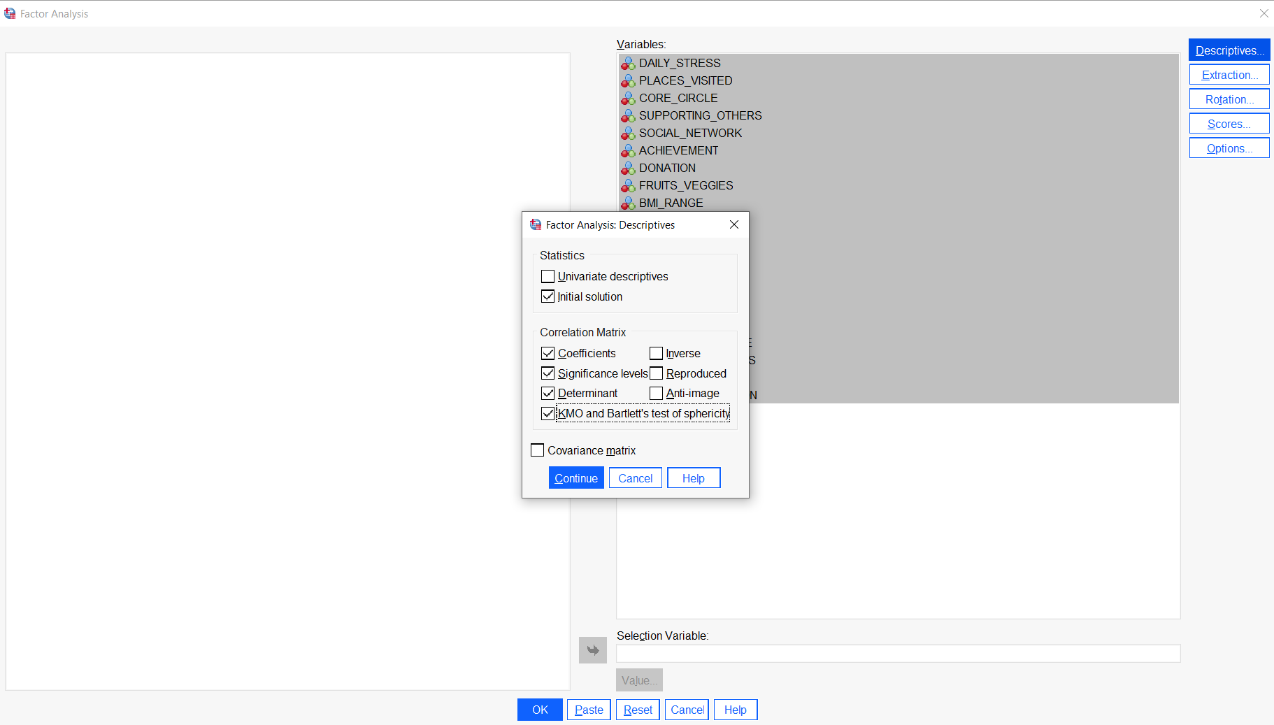
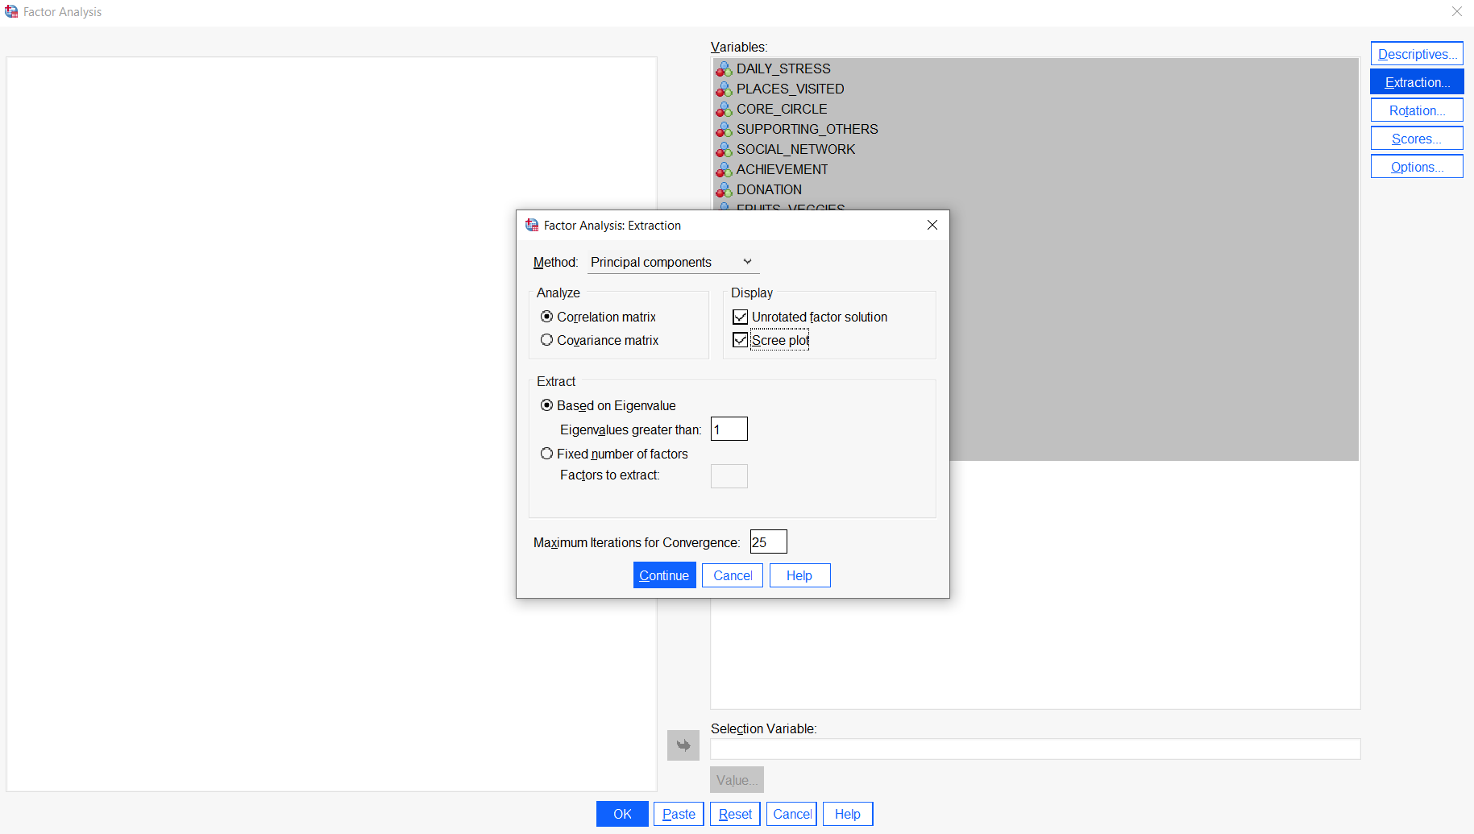
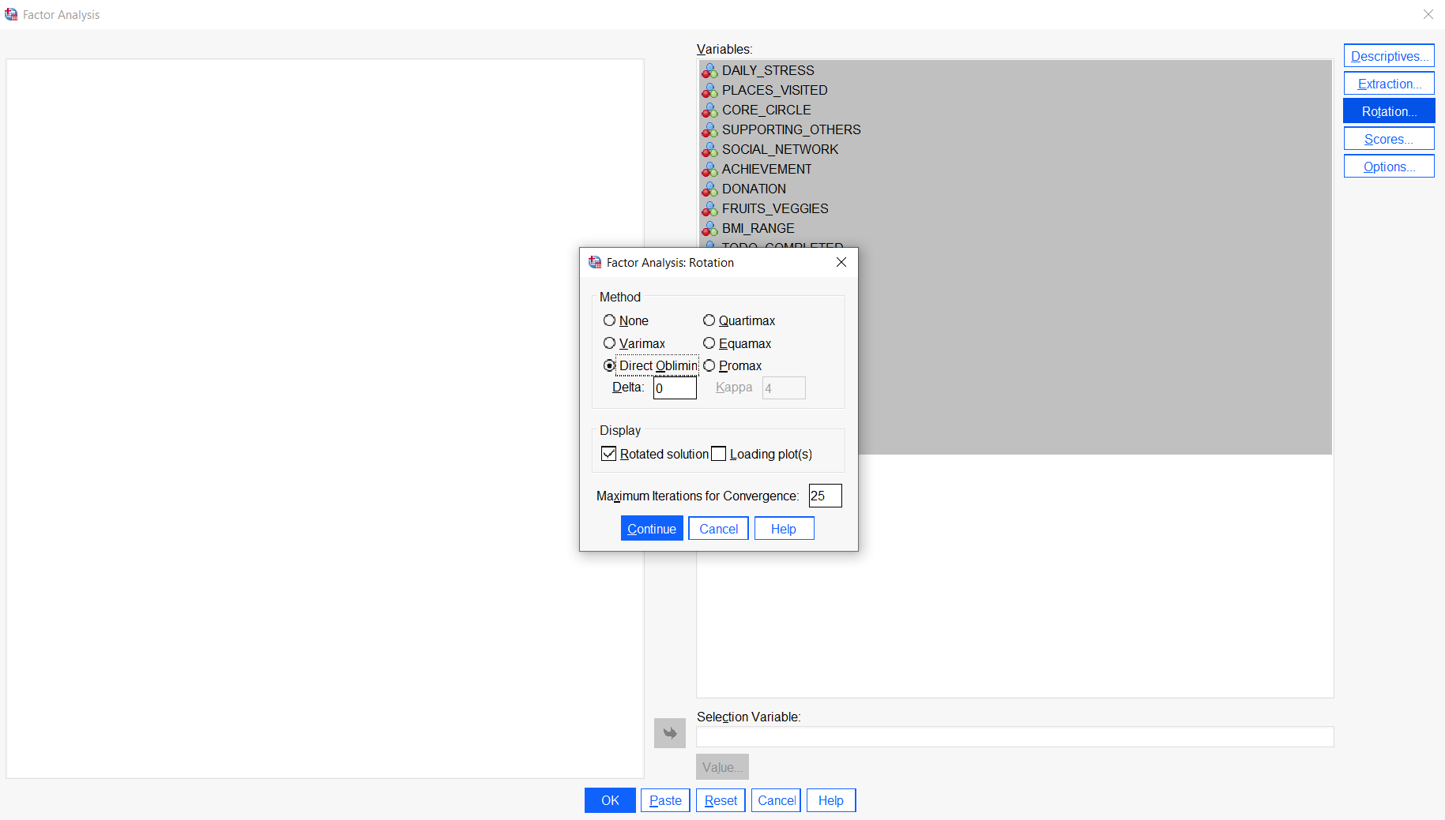
Primary Analysis : Oblimin Method
Descriptives
Extraction
Rotation

Slide 5
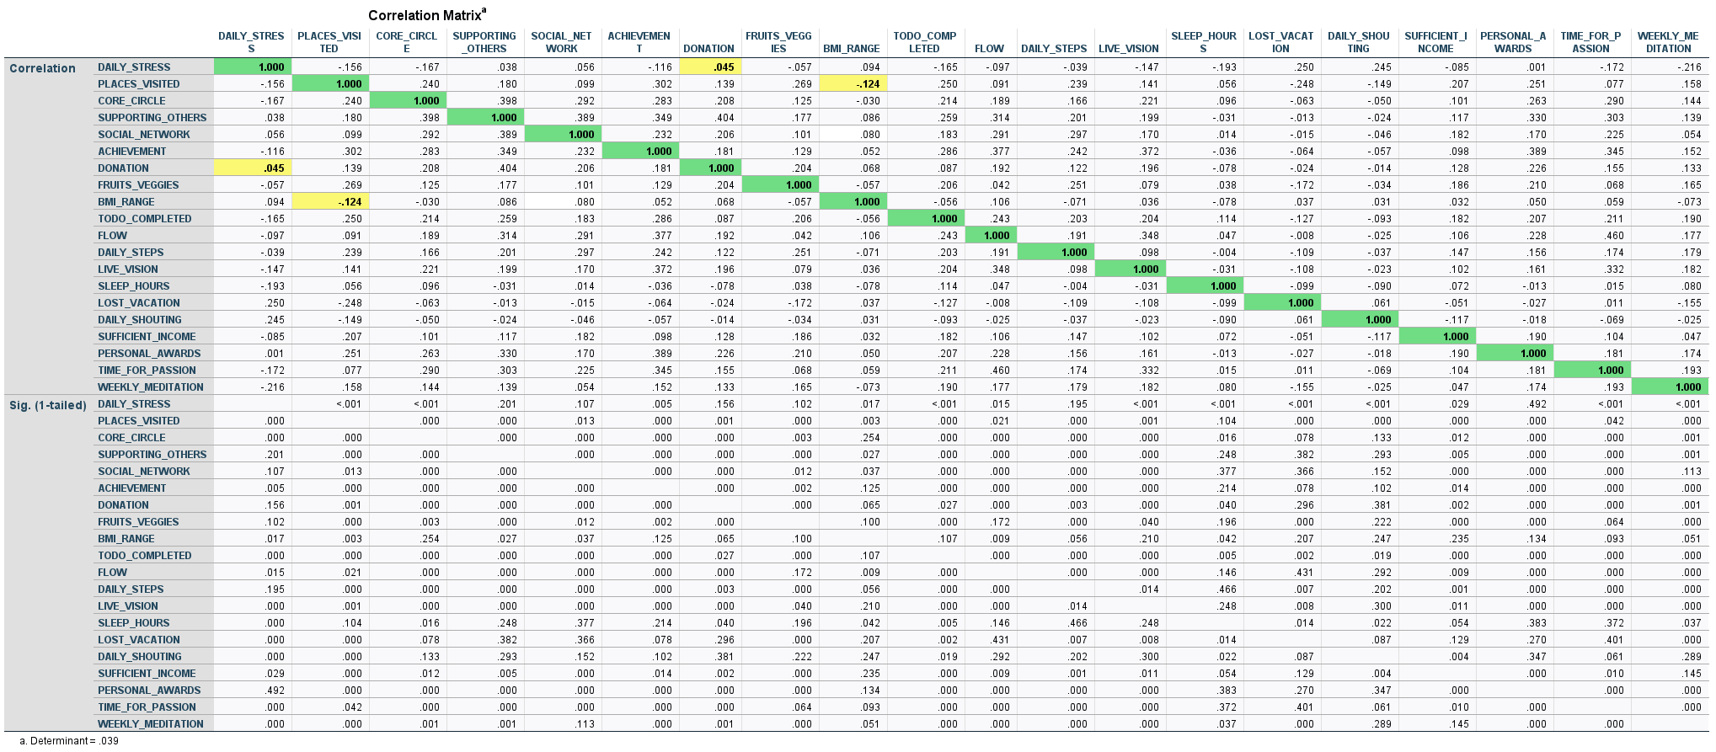

Factor Analysis : OBlimin Output
The value should be greater than .00001

Slide 6
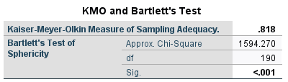
KMO and Bartlett’s Test :
A good sample size should be above 0.5 or greater.
To establish an adequate relationship, the value should be less than 0.05
Cont..

Slide 7
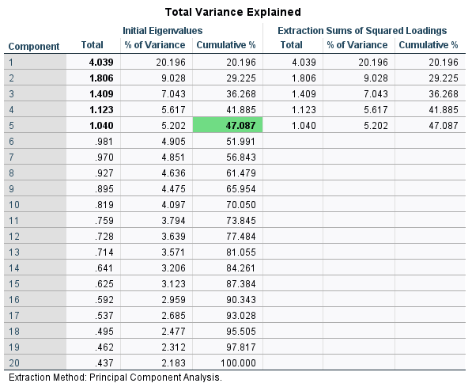
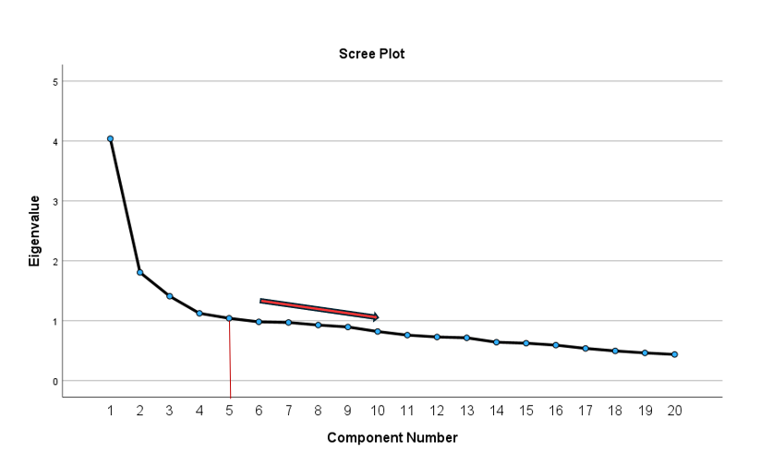
Total Variance Explained | Scree Plot :
Cont..

Slide 8
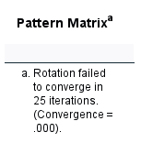
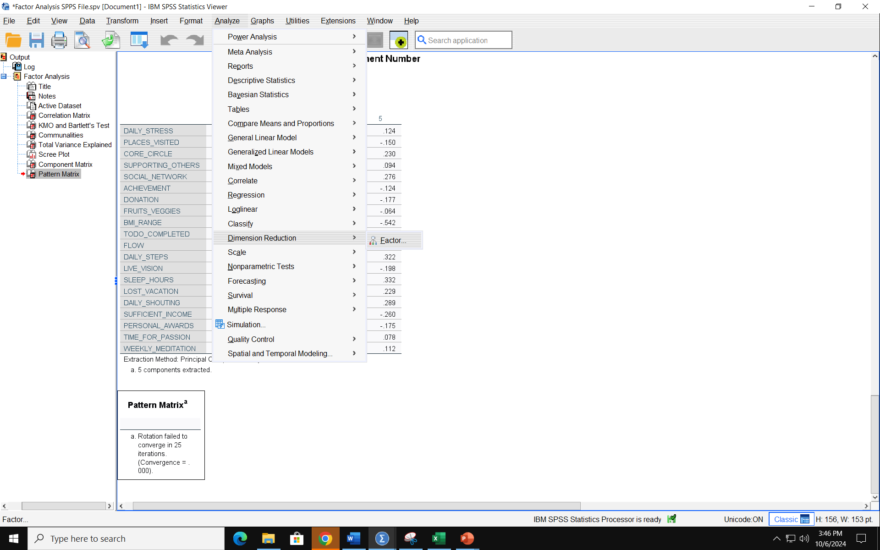
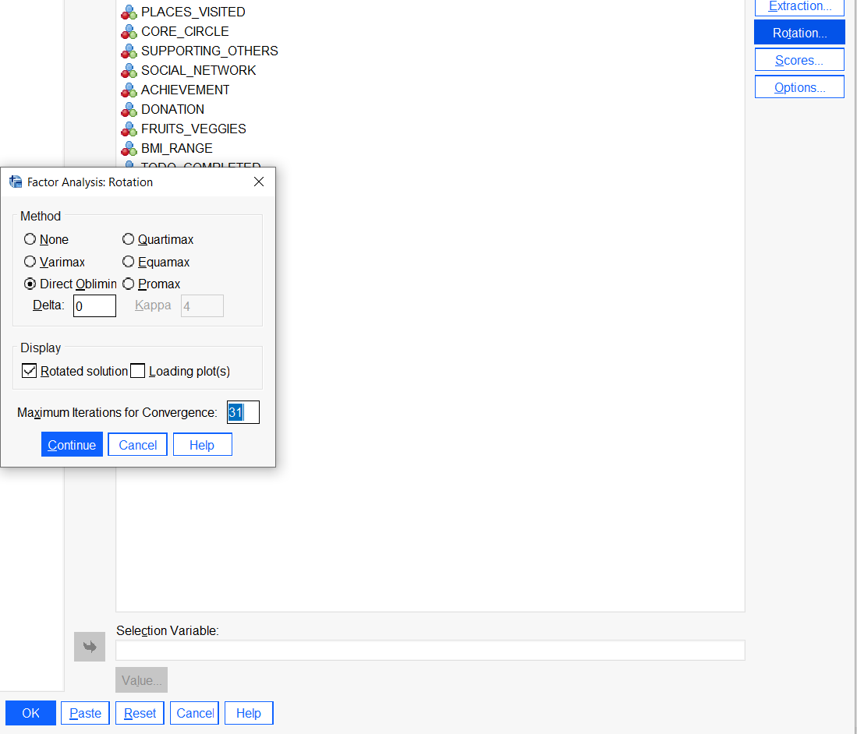
Pattern Matrix :
*Changed Convergence from 25 to 31
Cont..

Slide 9
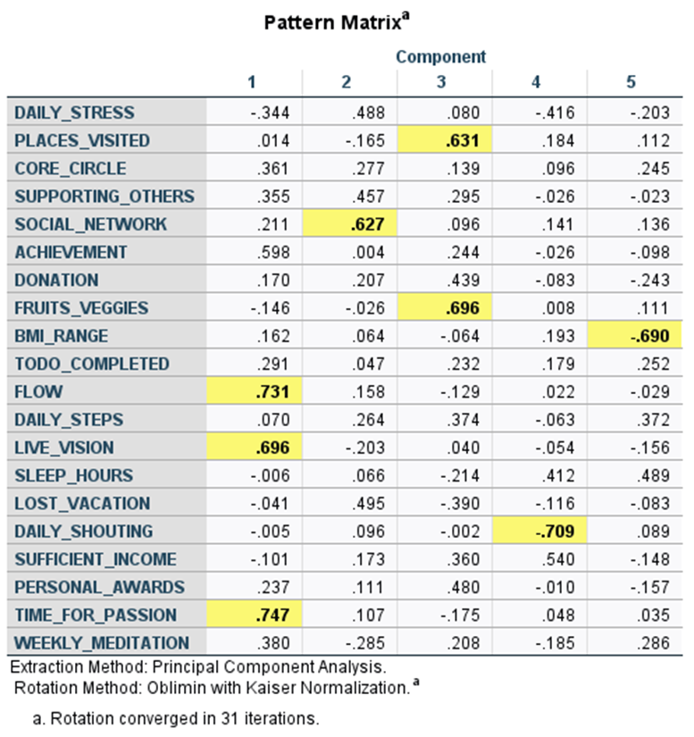
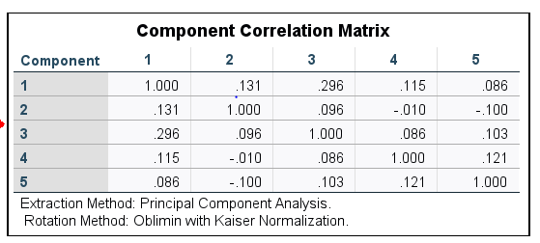
Pattern Matrix | Component Correlation Matrix:
We are looking for values above .32 or .5 to meet the test.

Slide 10
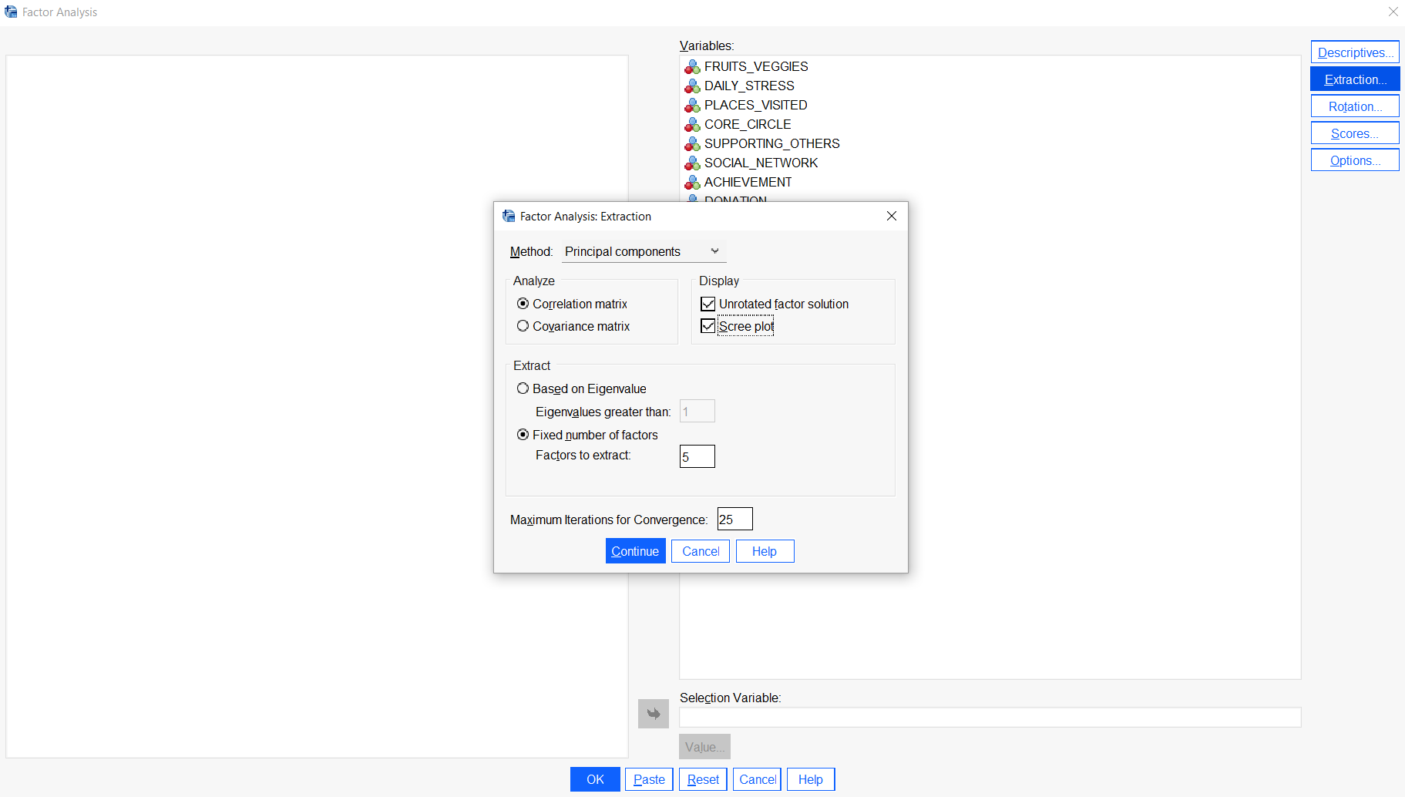
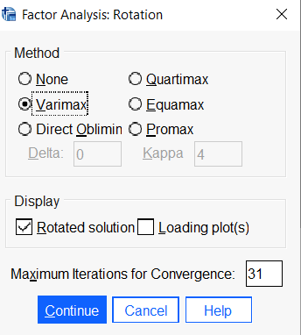
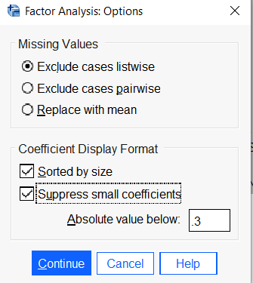
Secondary Analysis : Varimax Method
Extraction
Rotation
Options

Slide 11
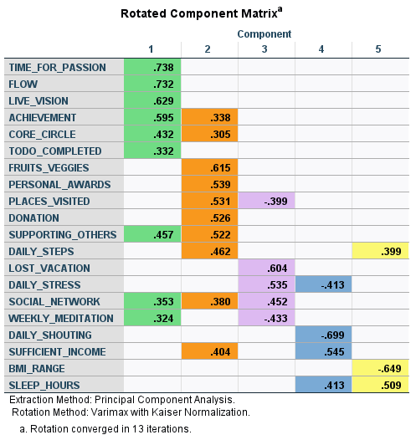
Rotated Component Matrix :
5 Factors of Wellbeing and Lifestyle
1
2
3
Life Satisfaction
Fulfillment and Community Engagement
Self- Care and Interaction
4
5
Mental Health and Economic Sufficiency
Wellness and Fitness

Slide 12
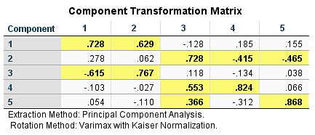
Component Transformation Matrix:

Slide 13
Conclusion:
Learned
Gained
Improved Insight
Utilization
Performance Monitoring : To track progress
Segmentation and Targeting : Identifying distinct groups and providing them counselling
Correlation Insight
Effective Method
Data Reduction
Validity of Measurements
Actionable Recommendation
Increased Accuracy
Predictive Modeling : To forecast future trends and behaviors

Slide 14

Thank you!

